Slide 1

Print

Slide 2
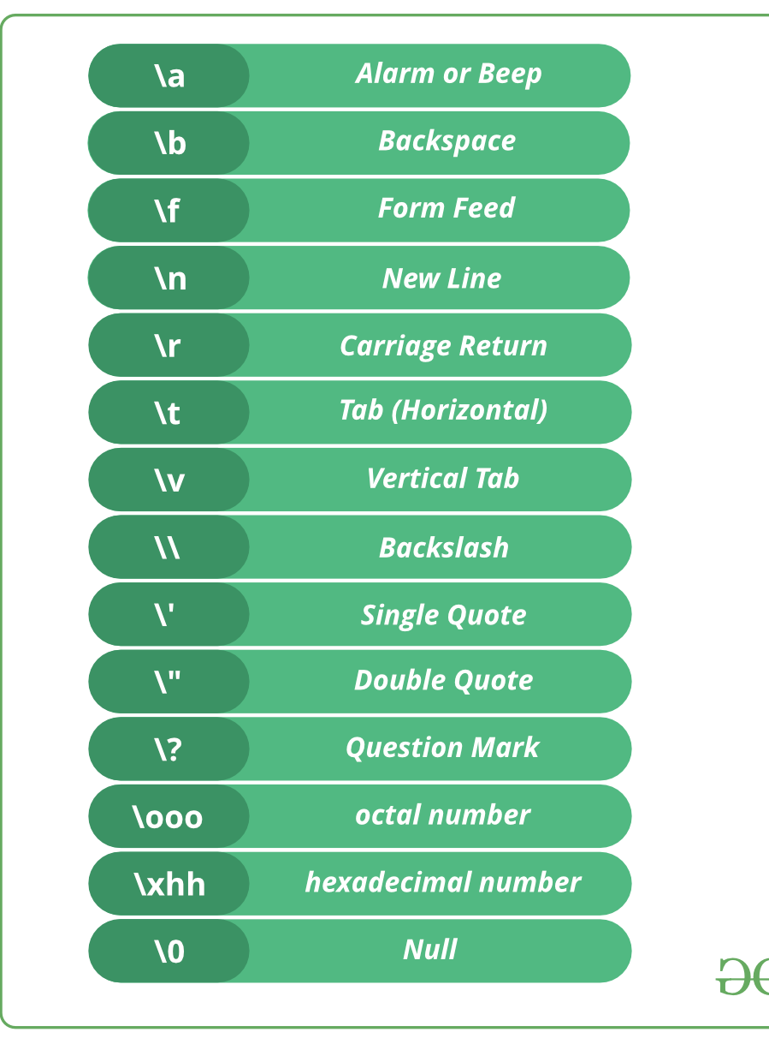

Slide 3

&
&

Slide 4

Variables
Suppose we have cabinets of different types. In each cabinet, we can only put one item. To store something in a cabinet, first, we’ll decide the cabinet type. Then, we’ll put a unique label on a cabinet to keep track of the item it contains.

Slide 5
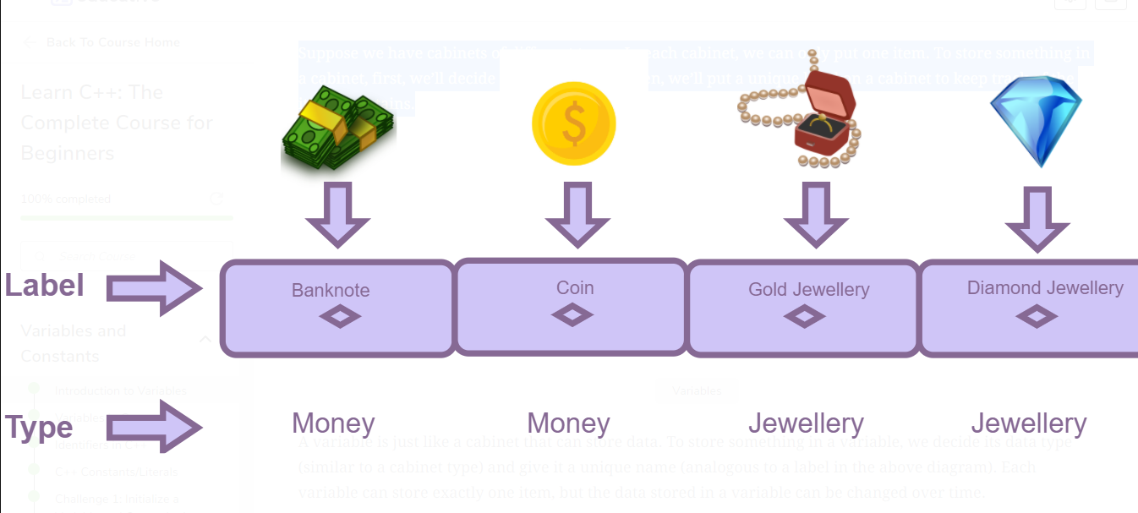

Slide 6
Names
An identifier can only contain uppercase alphabets (A to Z), lowercase alphabets (a to z), numbers (0 to 9), and underscore (_).
The first letter of an identifier can be an alphabet or an underscore.
The first letter of an identifier cannot be a number.
C is a case-sensitive language. Therefore, an identifier written in the upper case will be different from the one written in the lower case.
An identifier cannot contain white space.
An identifier cannot have special characters such as: &, @, *, !, etc.
We cannot use keywords as identifiers.

Slide 7
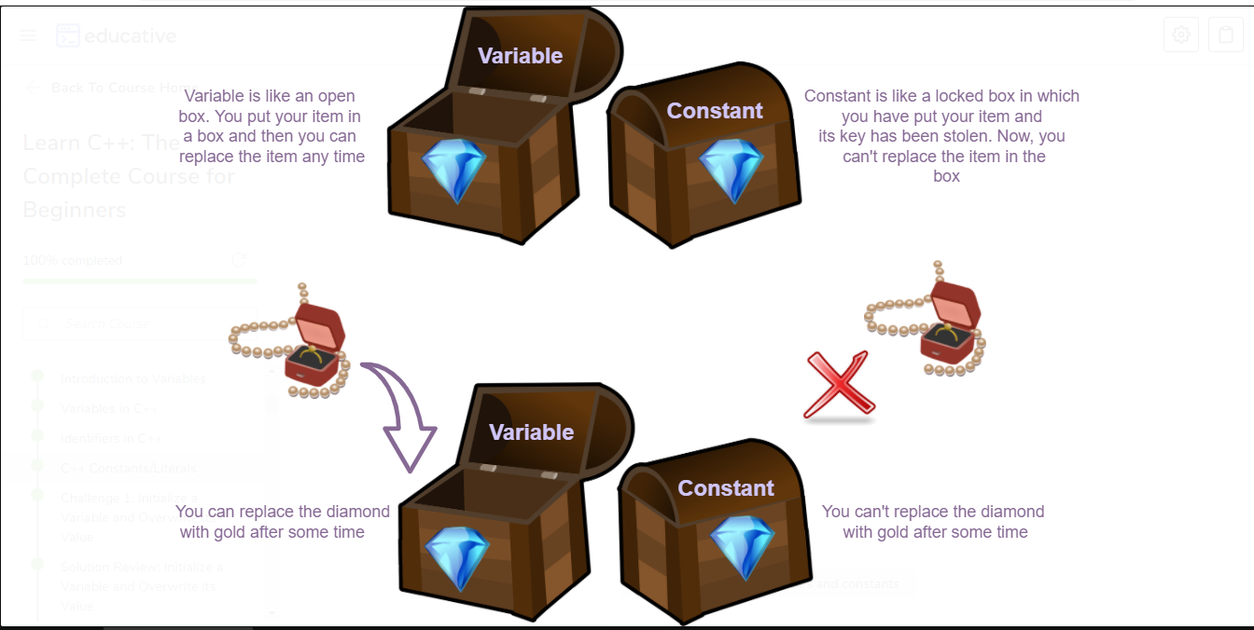
Constant

